Slide 1


a primer on physiological computing
facebook.com/BITalinoWorld
twitter.com/BITalinoWorld

Slide 2
Manuel Rocha
Consultor e Programador IT
facebook.com/rocha.manuel

Slide 3
BIO
SIGNAL

Slide 4
PHYSIOLOGICAL
COMPUTING

Slide 5
in the broadest sense, means building systems that incorporate software and hardware capable of sensing and responding to the physiological world

Slide 6
the easiest body signals to tap into come from the:
nervous, musculoskeletal, circulatory, respiratory, and integumentary systems

Slide 7
let’s run through a few examples

Slide 8
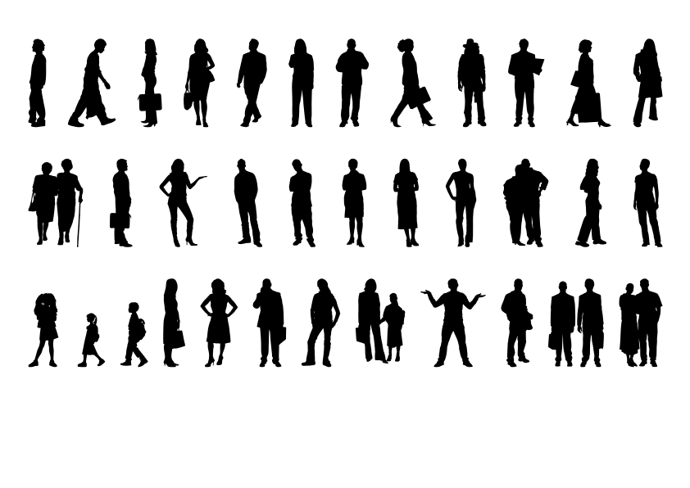
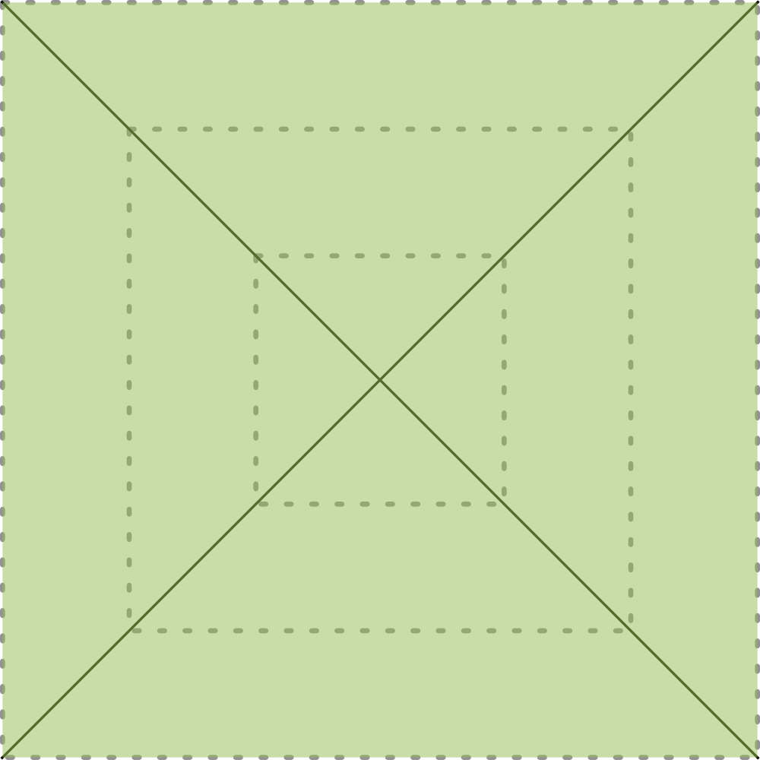

EMG | Muscle Signals
collect
where: above any muscle when: 1000Hz how: EMG - voltage issues: motion artifacts, ECG interference, bad grounding, powerline noise
extract
muscle contraction duration muscular tension activation timing (between muscles)
process
onset detection envelope detection noise removal spectral analysis
understand
movement strategies muscle coordination muscle fatigue anxiety level
C.
A.
O.
S.

Slide 9
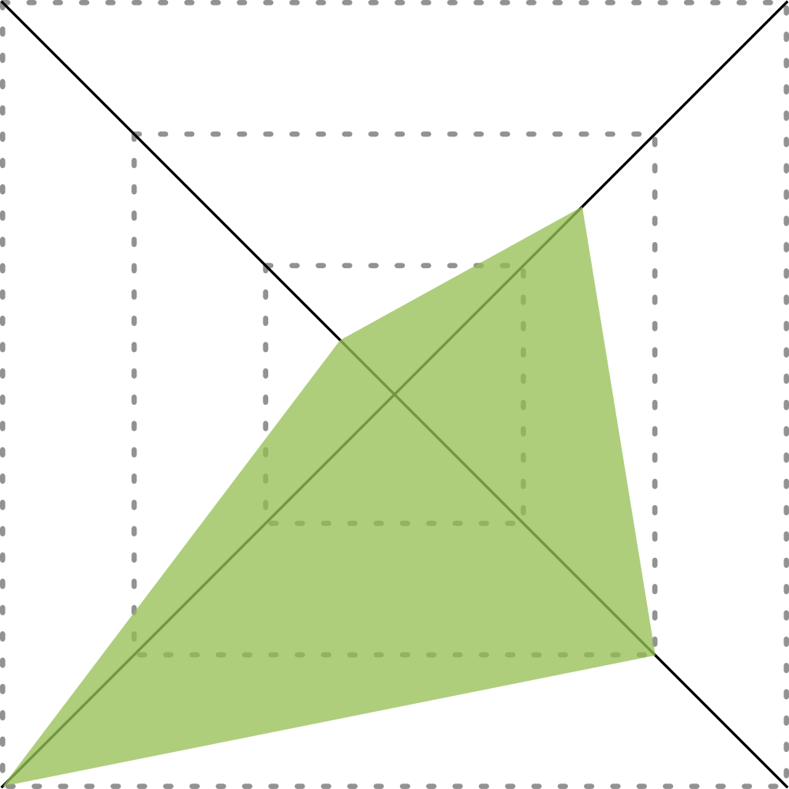
ECG | Cardiac Signals
collect
where: chest, hands, or neck when: 250Hz how: ECG - voltage issues: motion artifacts, EMG interference, powerline noise
extract
heart rate/heart rate variability fiducial points annotation R-peak amplitude (modulated by respiration)
process
peak detection segmentation noise removal
understand
stress/concentration level cardiac dysfunctions physical effort
C.
A.
O.
S.

Slide 10
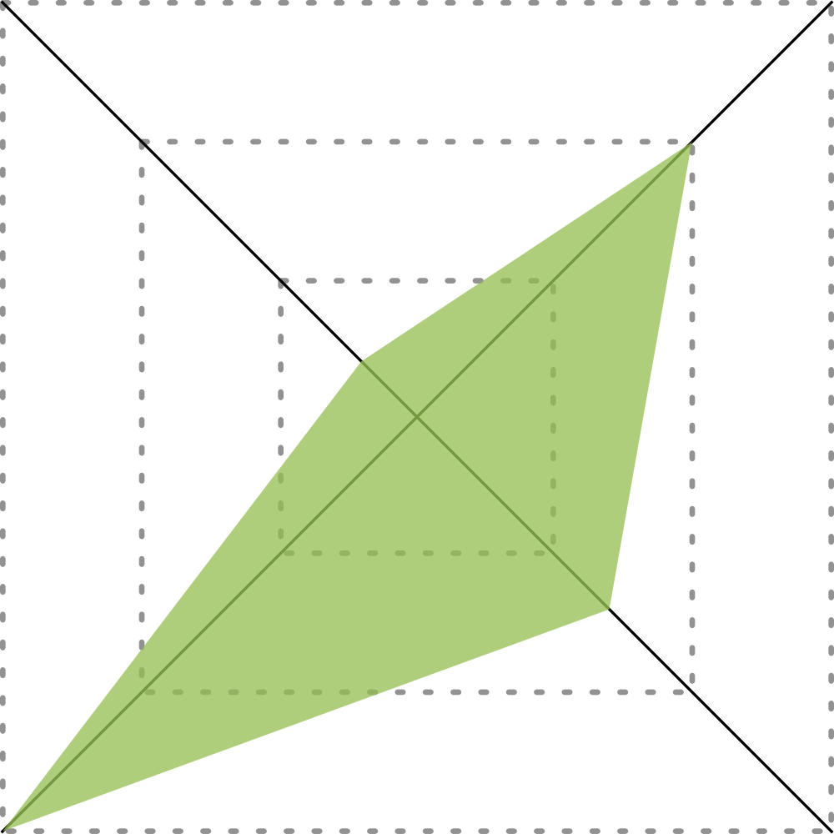
EDA | Emotional Arousal
collect
where: sweat glands when: 2Hz how: EDA - resistance issues: ambient hear, motion artifacts, powerline noise
extract
event amplitude rise time tonic level
process
onset detection noise removal peak detection
understand
reaction to a stimuli hyperhidrosis arousal level
C.
A.
O.
S.

Slide 11

Accelerometer | Motion
collect
where: skin surface when: 1Hz how: MEMS - capacitance issues: motion artifacts, natural tremors
extract
movement patterns step counting tilt/angle
process
epoching noise removal spectral analysis
understand
metabolic equivalent of task gestures/posture range of motion
C.
A.
O.
S.

Slide 12
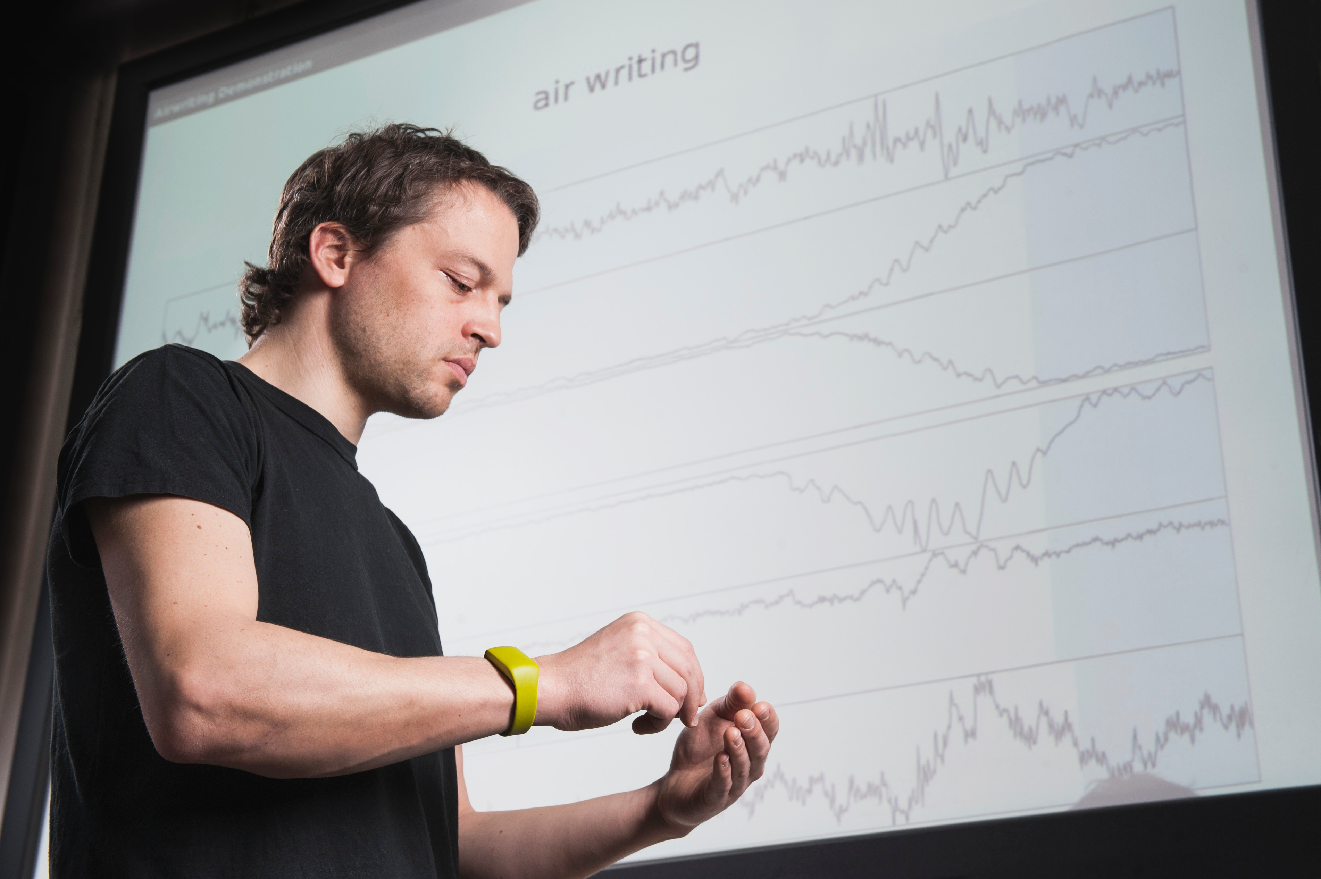

Slide 13
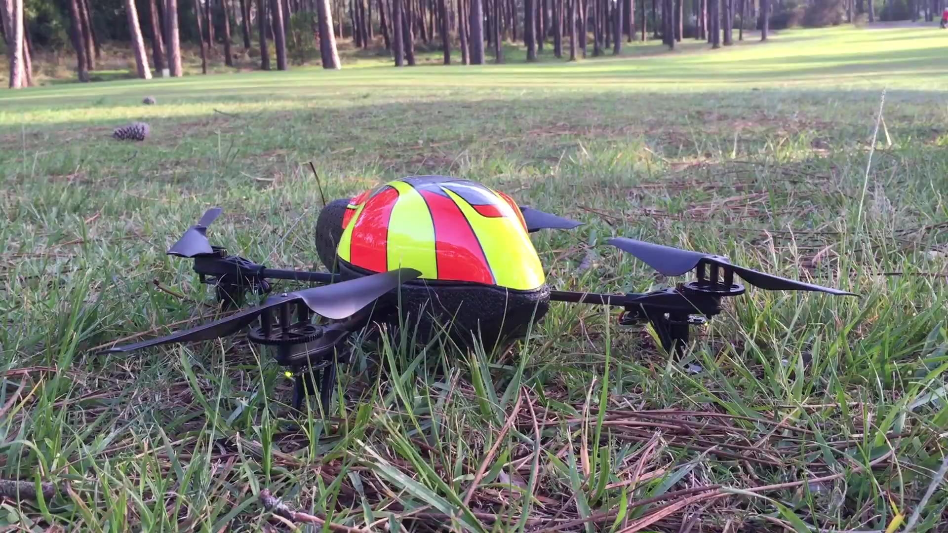

Slide 14
I want to get physiological… now what?

Slide 15
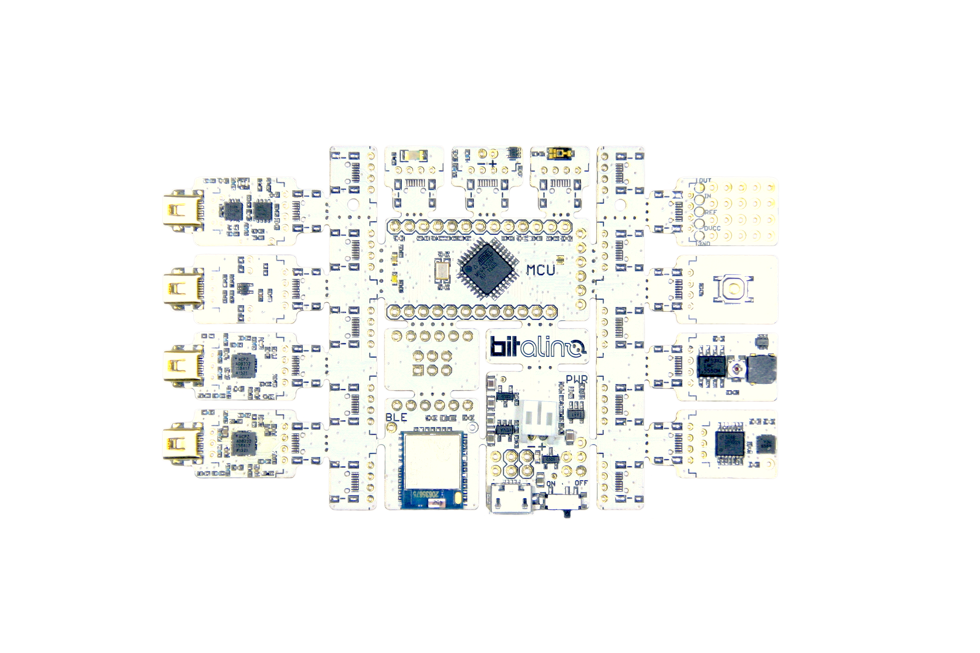
the most advanced DiY kit for biosignals...
Digital-to-Analog Converter (DAC)
LED
video camera sync
Light Sensor (LUX)
computer screen sync
Electroencephalography (EEG)
brain activity
Prototyping Board (PRT)
interface for custom accessories
Electrodermal Activity (EDA)
sympathetic nervous system
Pushbutton (BTN)
manual event annotation
Micro-controller unit (MCU)
Electrocardiography (ECG)
cardiac activity
Buzzer (BUZ)
audio feedback
AVR ISP 6-pin header
Electromyography (EMG)
muscle activity
Accelerometer (ACC)
motion
BLE
Bluetooth also available
Power
3.7V Li-Po w/ charger

Slide 16
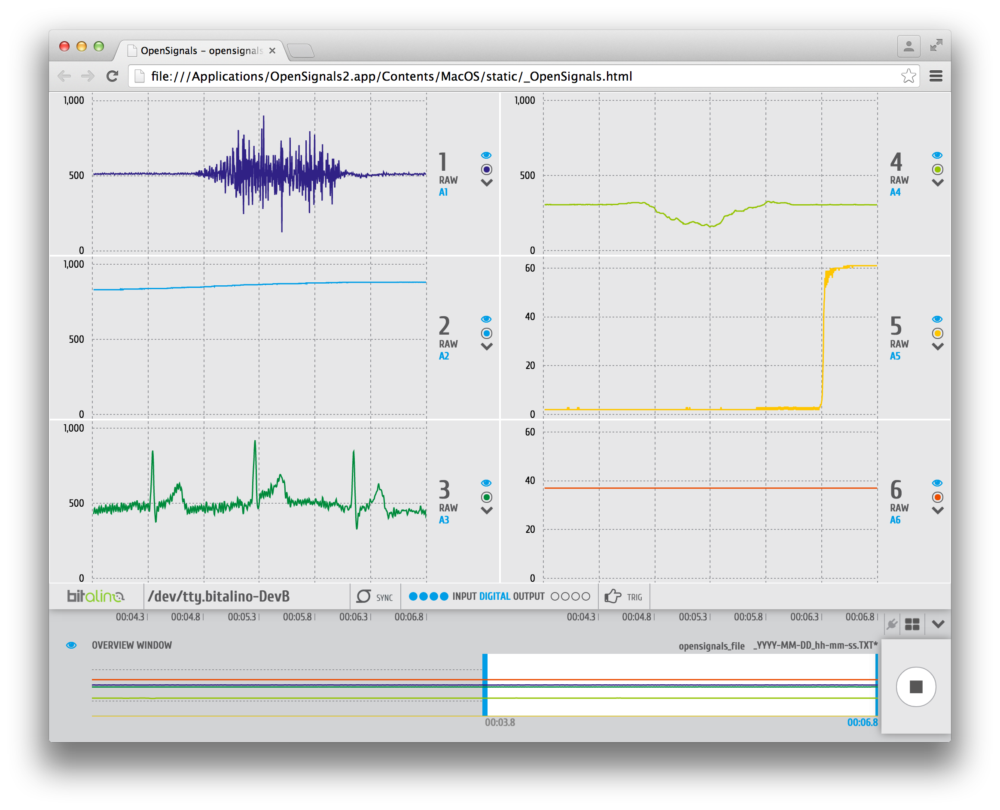
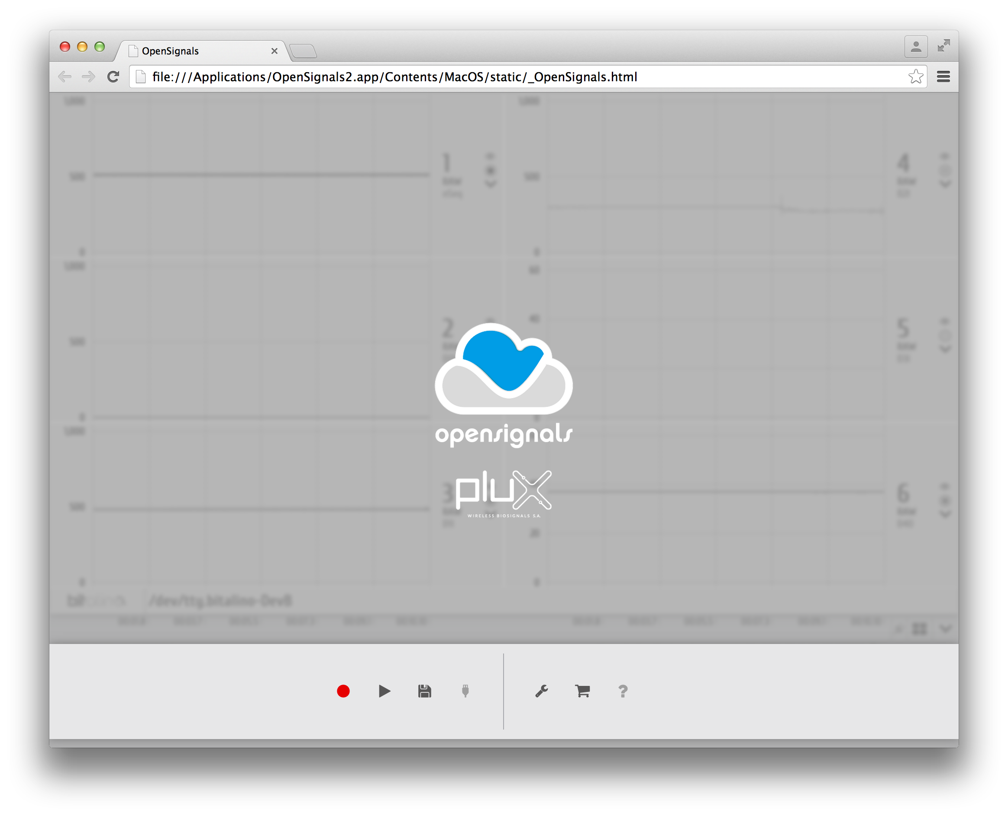
there’s free software to go with it as well

Slide 17










programming APIs

Slide 18
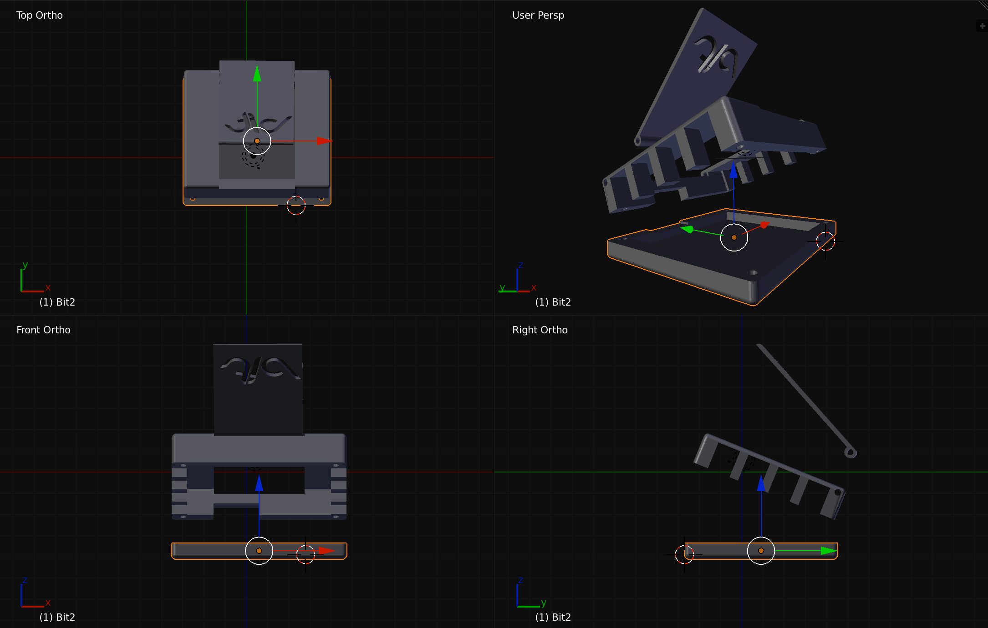


Slide 19
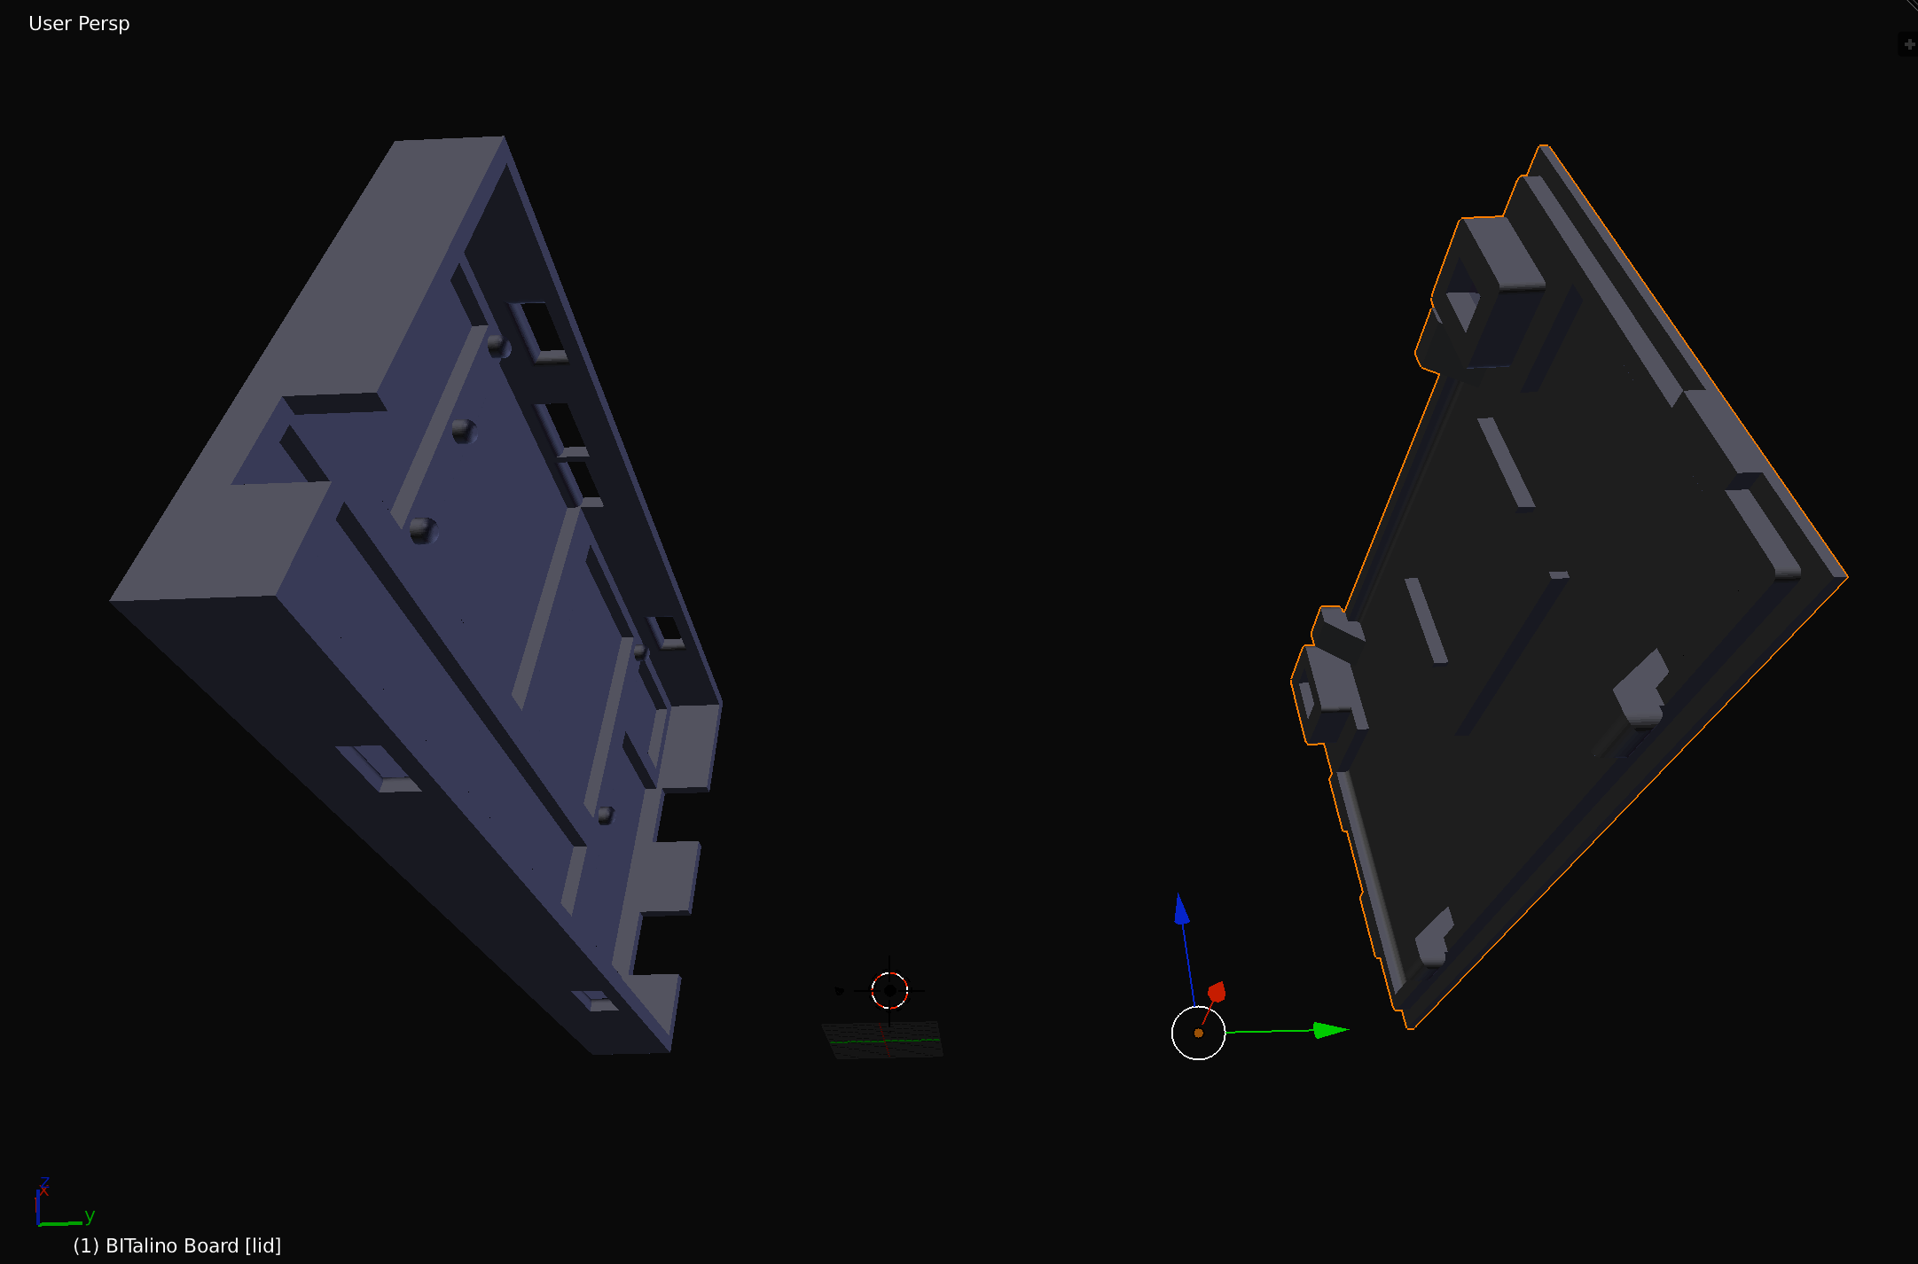


Slide 20
hands-on

Slide 21
real-time sampling and conversion of the analog sensor outputs to a digital representation

Slide 22
CAN WE
UPLOAD
OUR OWN
CODE?

Slide 23
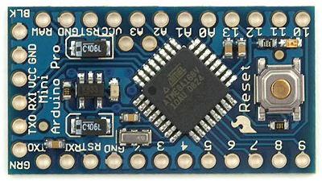
yes, but may be easier to use an Arduino

Slide 24
HOW
ABOUT
STANDALONE
APPLICATIONS?

Slide 25
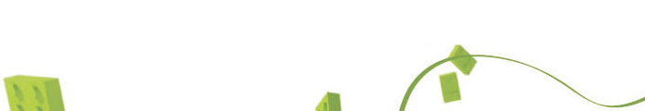
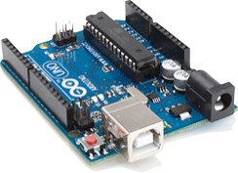
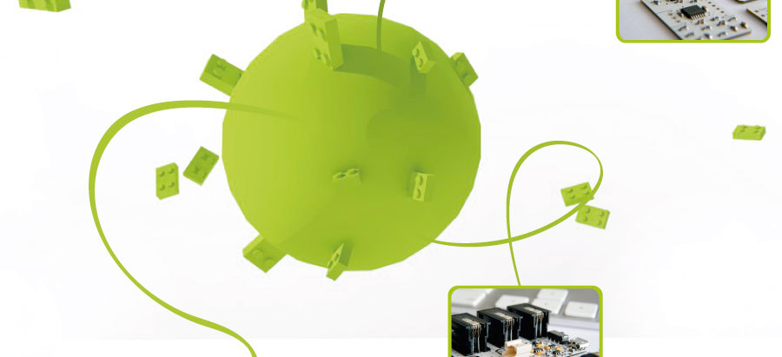
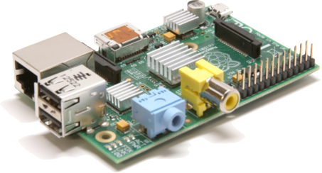
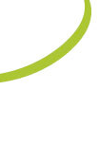
maybe easier with a 3rd party system

Slide 26
3.3V and 1.65V regulated power supply, with battery charger and voltage information

Slide 27
WHAT IS
THE BATTERY
LIFE?

Slide 28
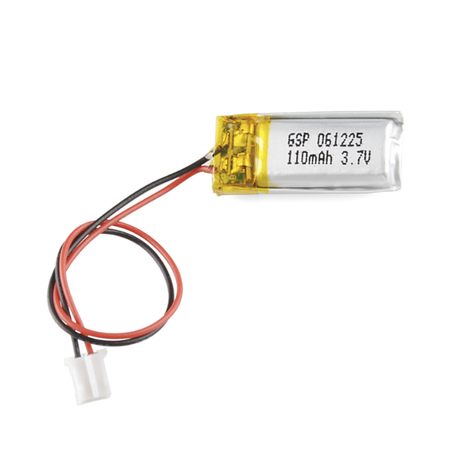
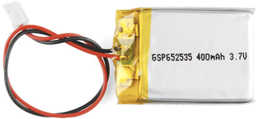
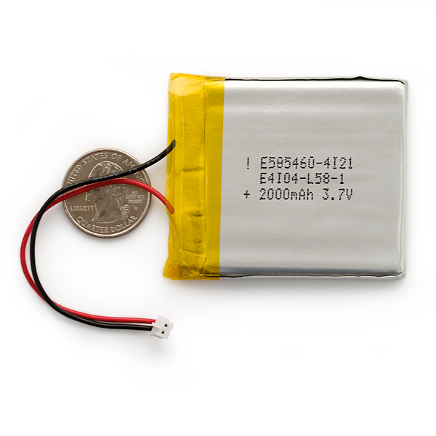
~10h with included battery

Slide 29
interchangeable Bluetooth communication interface with 115.2k bps transfer rate

Slide 30
WHAT
OTHER
INTERFACES
CAN YOU
USE?

Slide 31
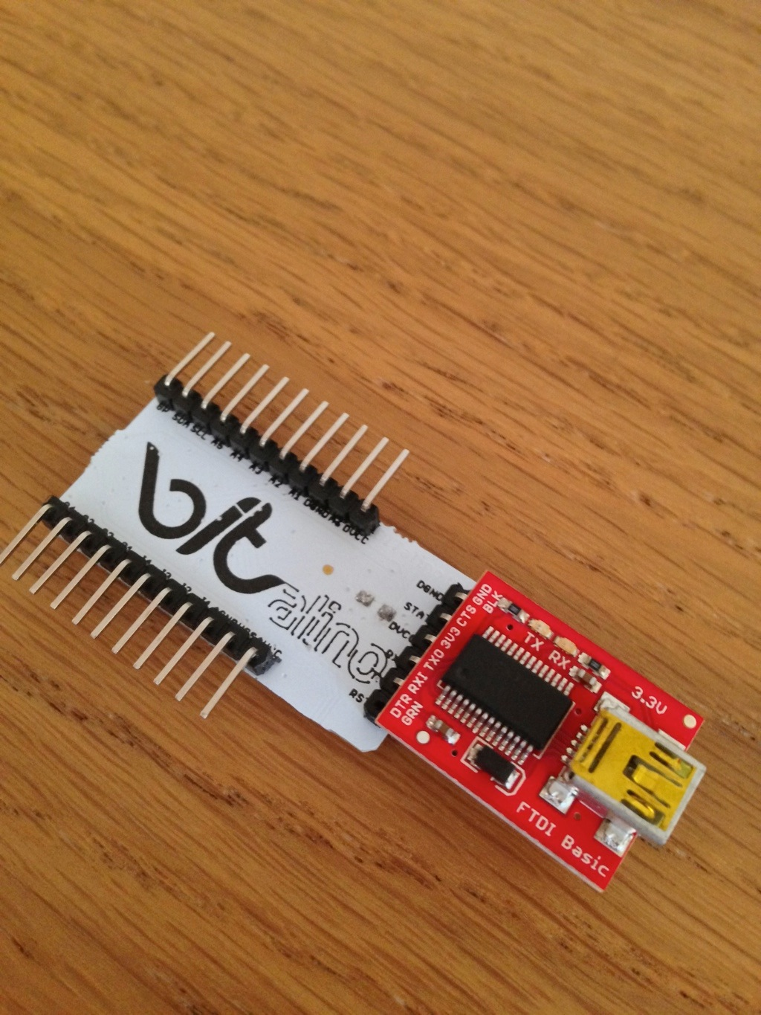
any UART-compatible adapter or device
https://www.how.do/guide/bitalino-usb-interfaces

Slide 32

MAKE SURE YOU ARE DIRECTLY AND INDIRECTLY DECOUPLED FROM A HIGH VOLTAGE SOURCE WHEN USING LOW IMPEDANCE SENSORS
G. Mathew. “Medical Devices Isolation: How Safe is Safe Enough,” Wipro Technologies, White Paper. 2002.

Slide 33
ANY
ACCESSORY
WITH A VOLTAGE
OUTPUT
CAN BE
USED!

Slide 34
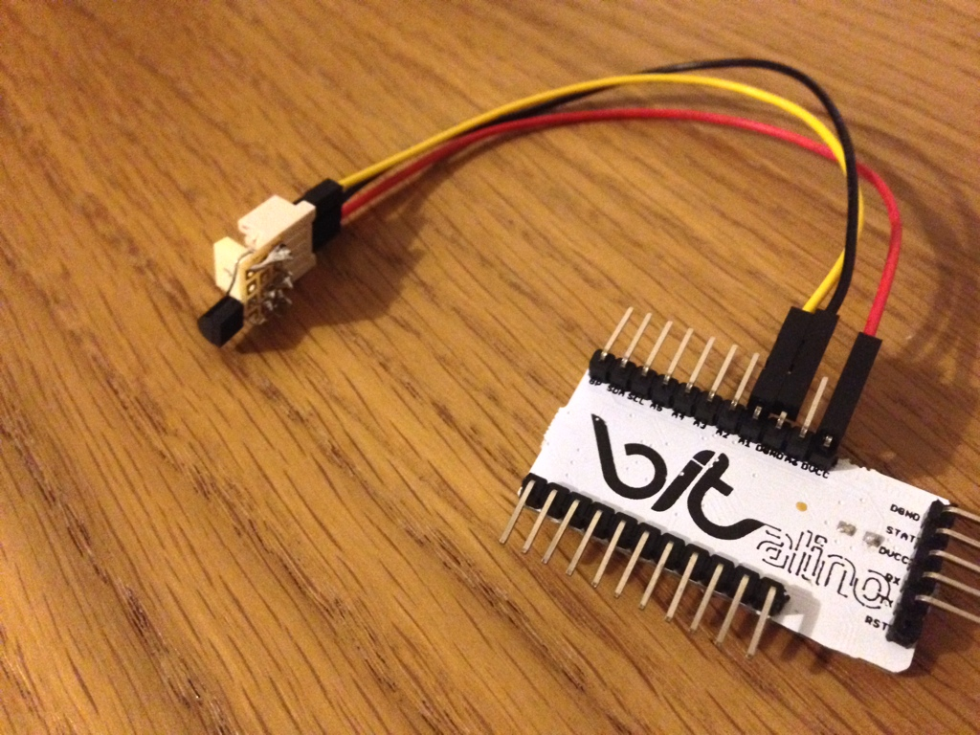
analog temperature sensor
https://www.how.do/guide/bitalino-a-tmp36-sensor

Slide 35
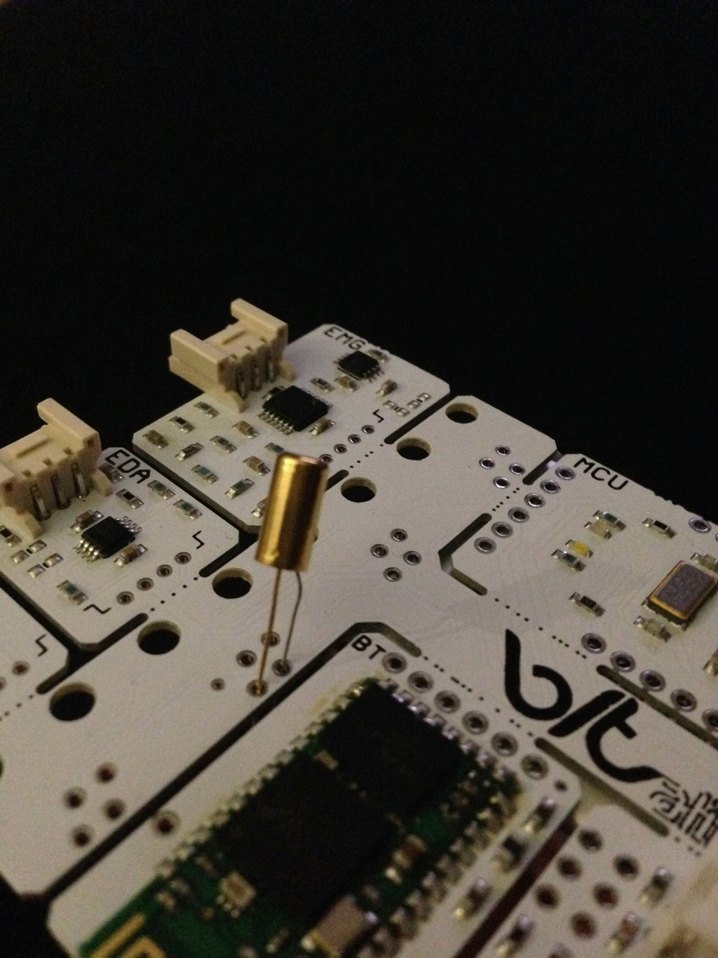
tilt switch on a digital input
https://www.how.do/guide/bitalino-a-tilt-switch

Slide 36
ARE THE
SENSORS
COMPATIBLE
WITH OTHER
SYSTEMS?

Slide 37
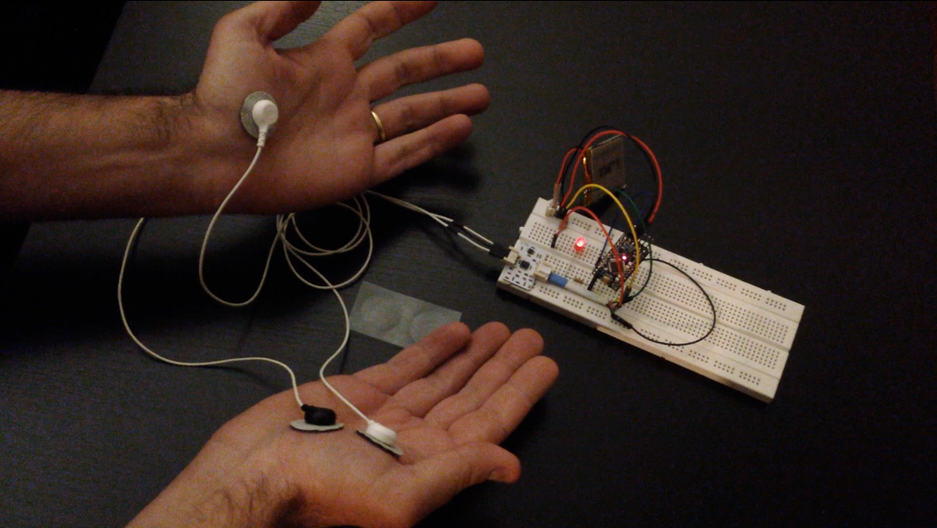
https://www.how.do/guide/bitalinoarduino-basics

Slide 38
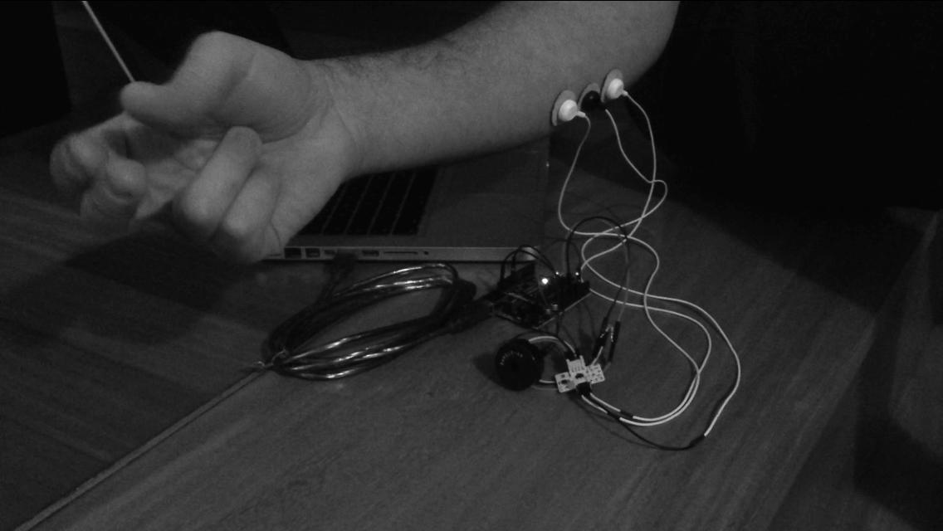
https://www.how.do/guide/bitalino-train-that-tempo

Slide 39
ALL VERY NICE
BUT I REALLY
WANT A
MINIATURIZED
DEVICE

Slide 40
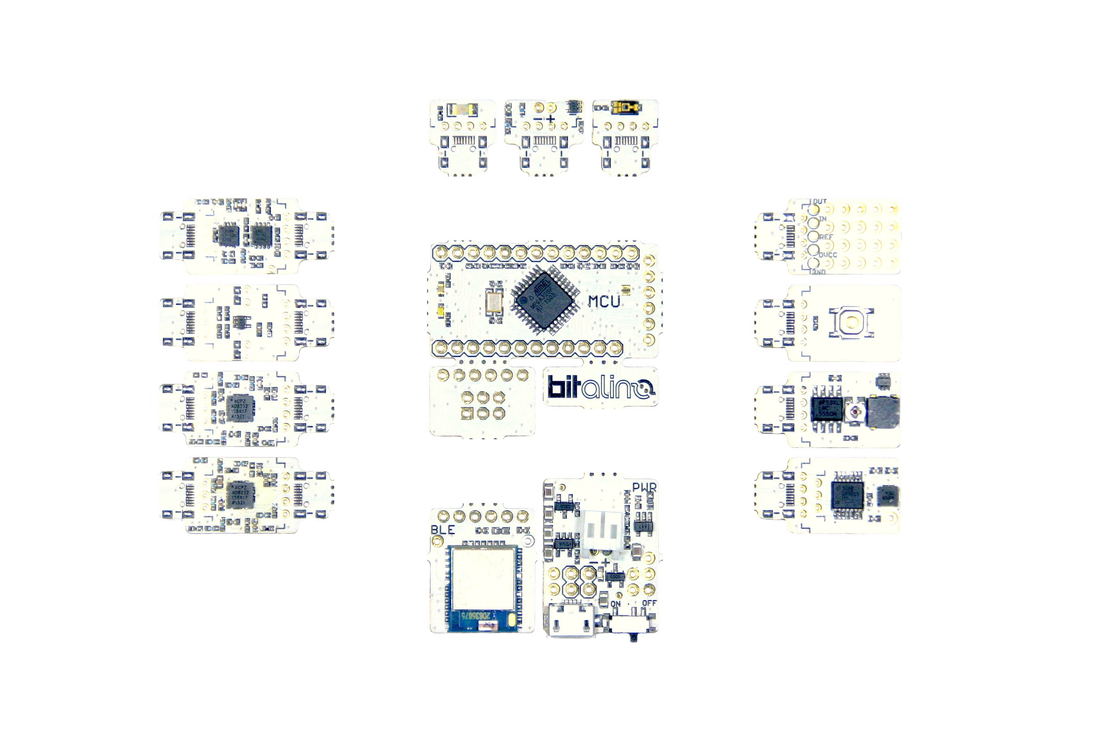
imagination is really the limit!

Slide 41
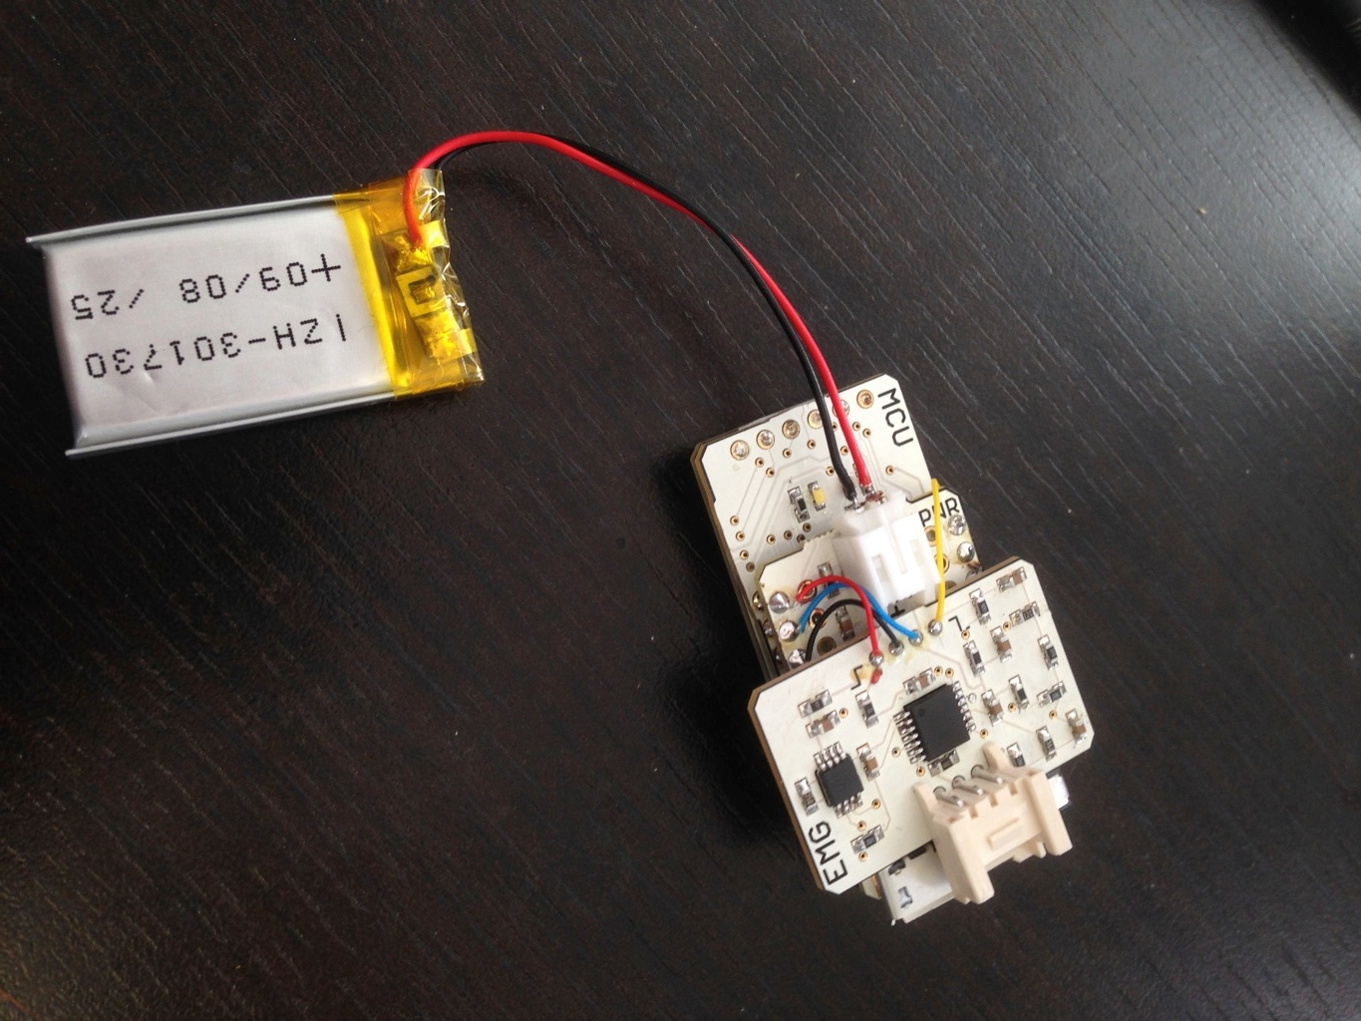
https://www.how.do/guide/go-freestyle-w-bitalino

Slide 42
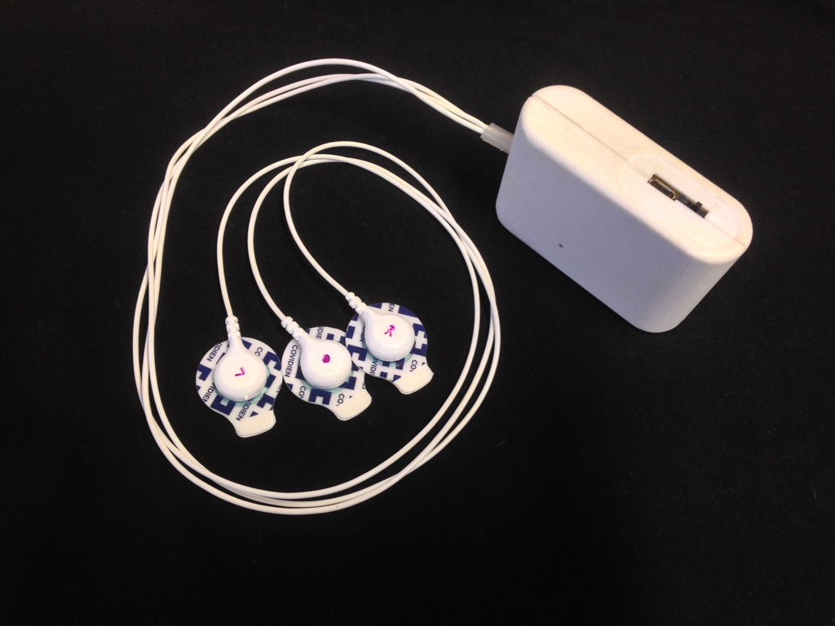

Slide 43
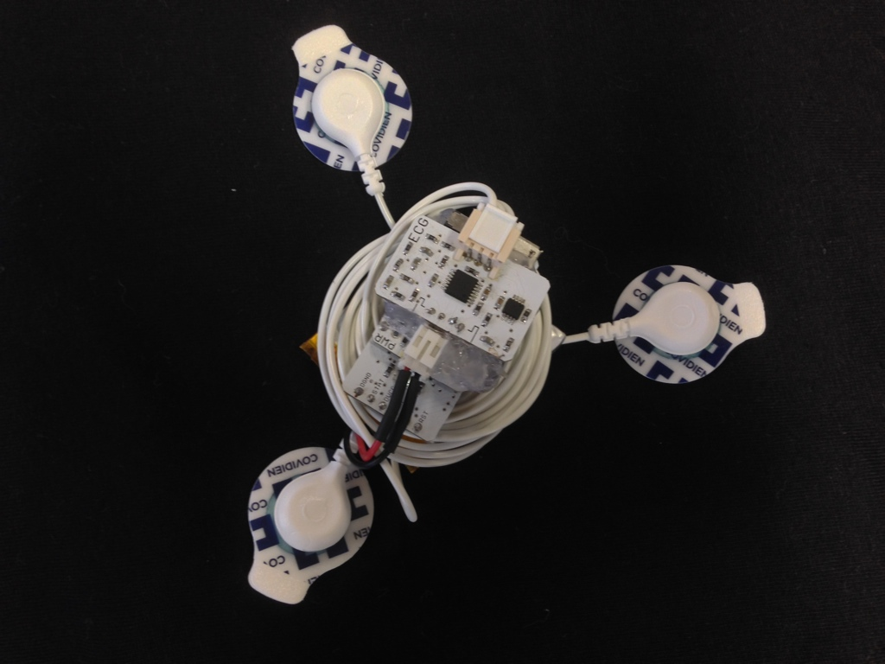

Slide 44
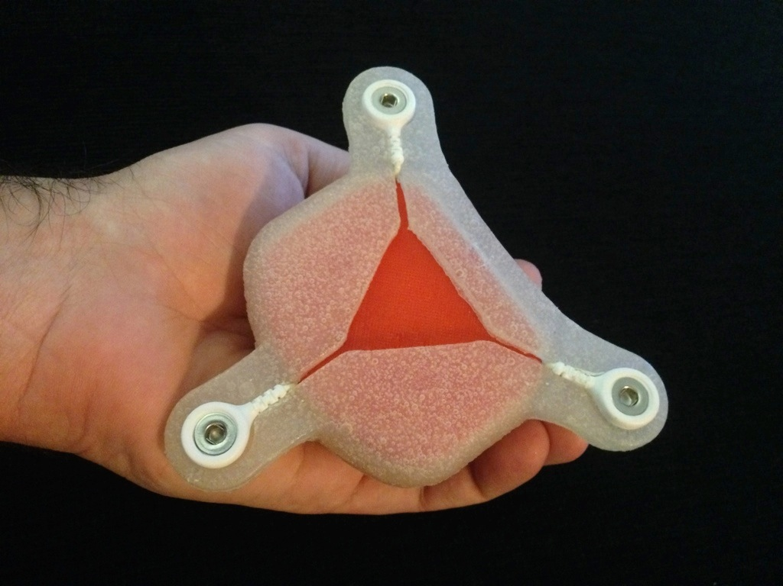

Slide 45
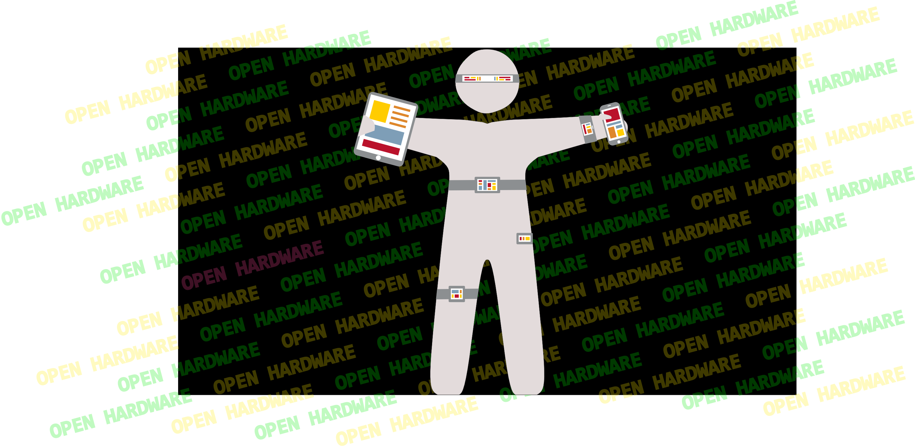

Slide 46
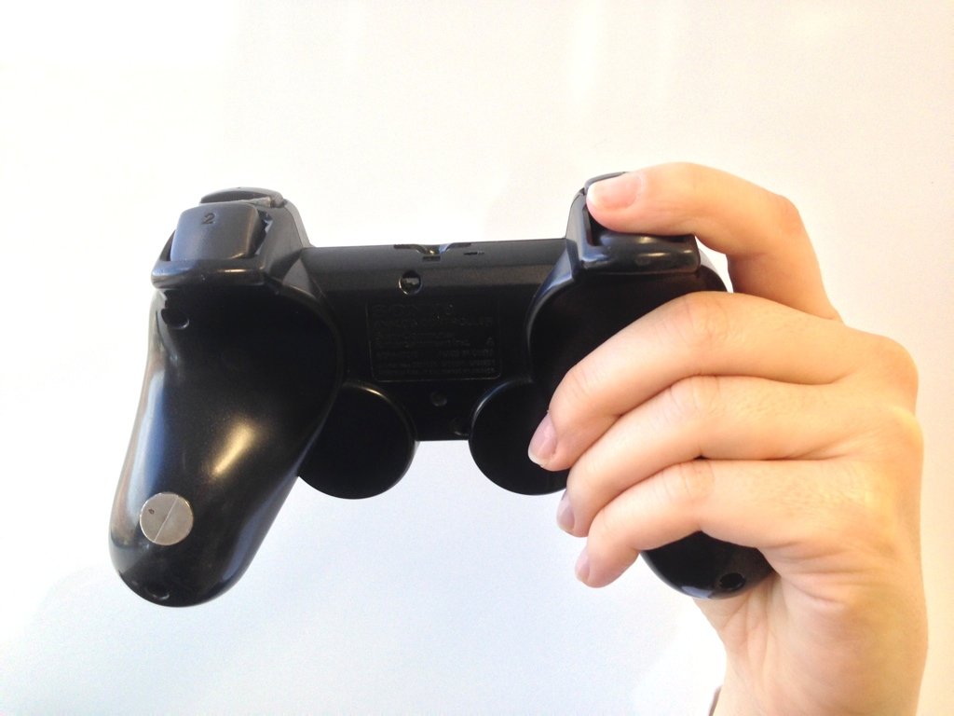

Slide 47
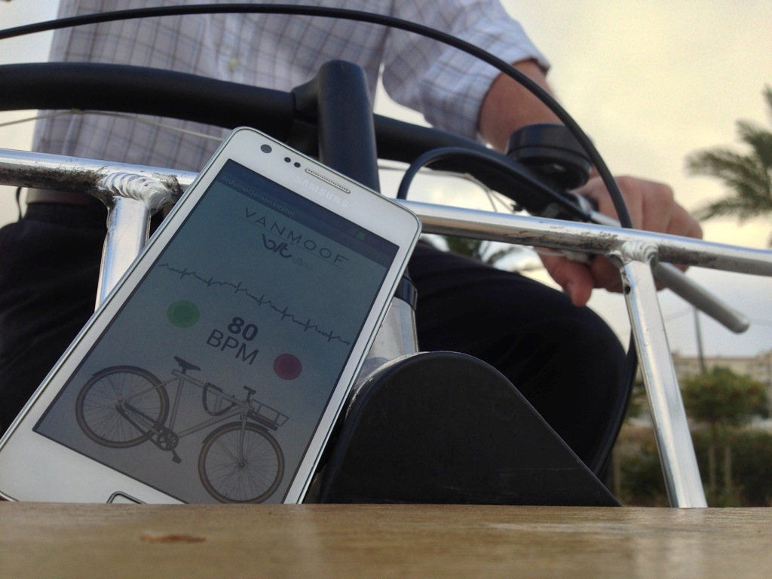

Slide 48
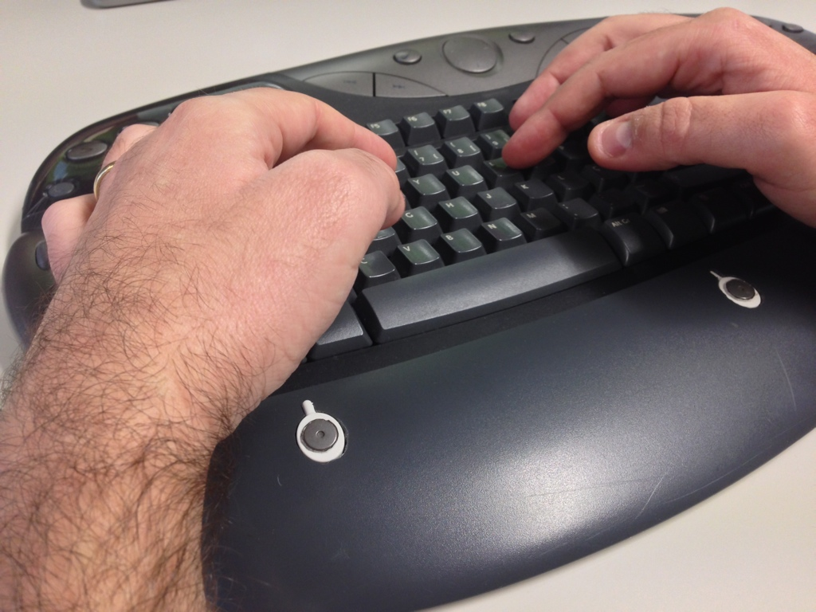

Slide 49
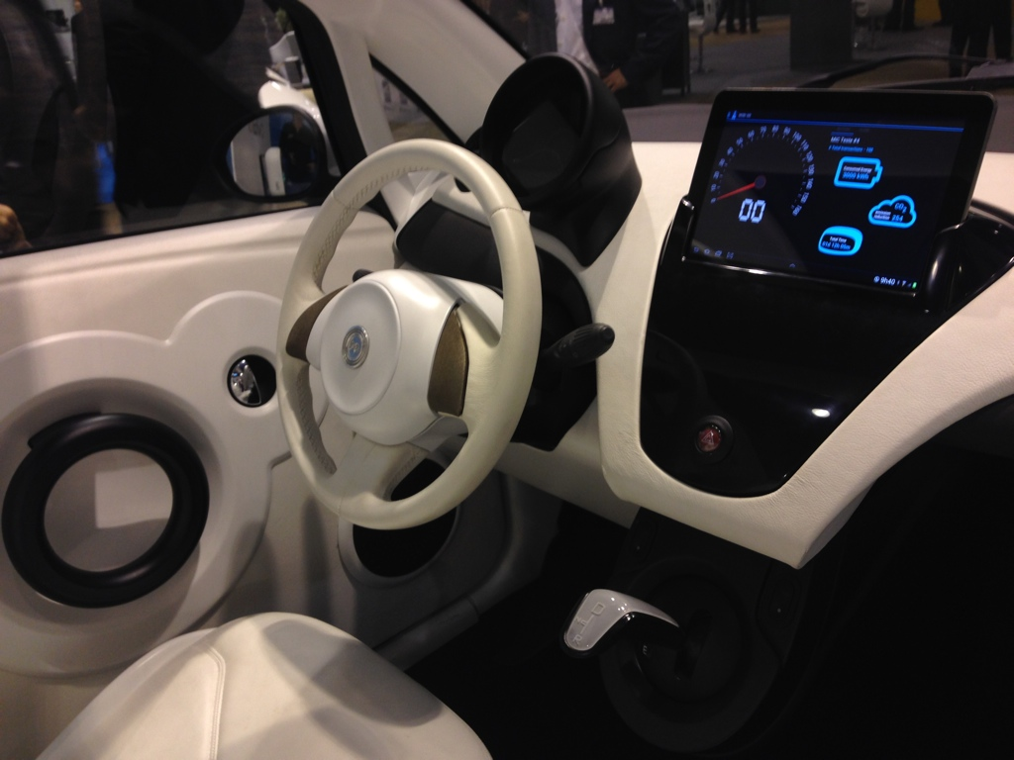

Slide 50
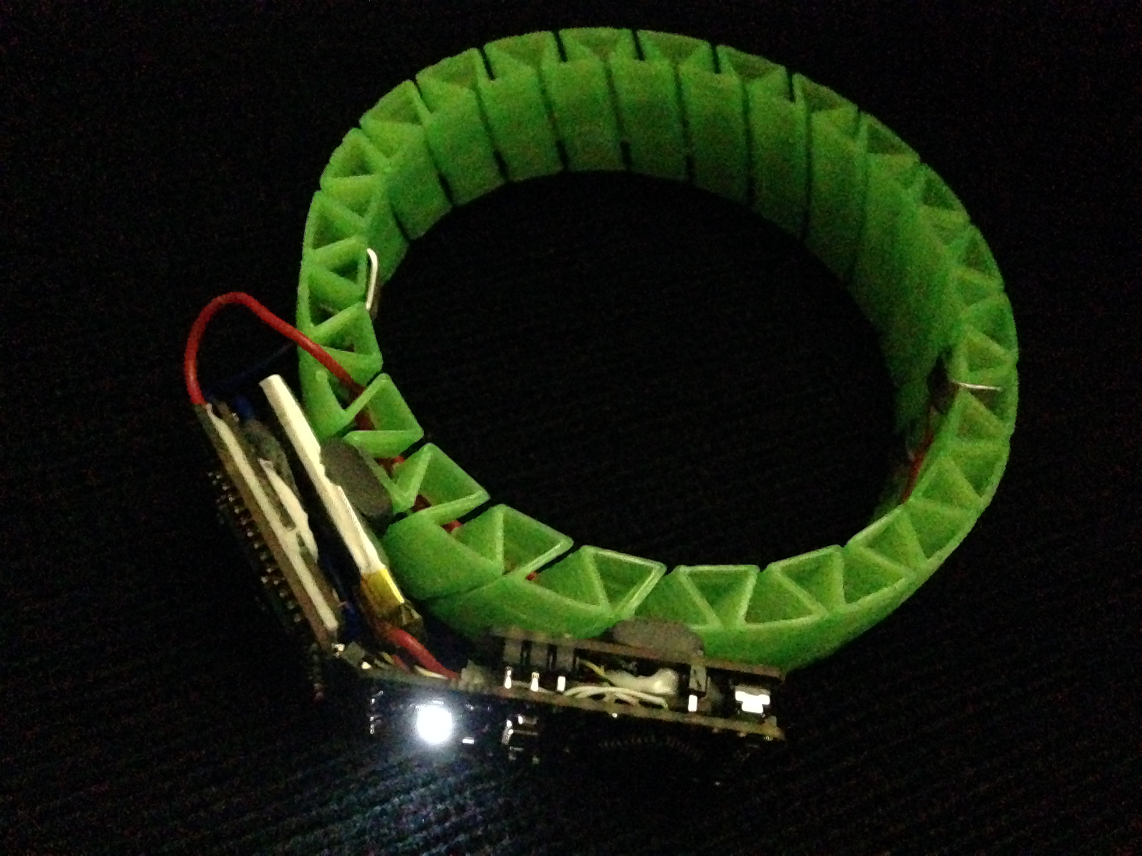

Slide 51
rapid application development

Slide 53


RAD front end
“batteries-included” backend

Slide 54
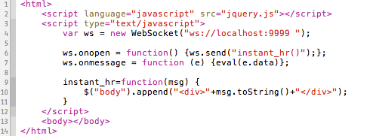
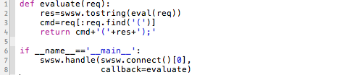

Slide 56
sneak peak of an API

Slide 57
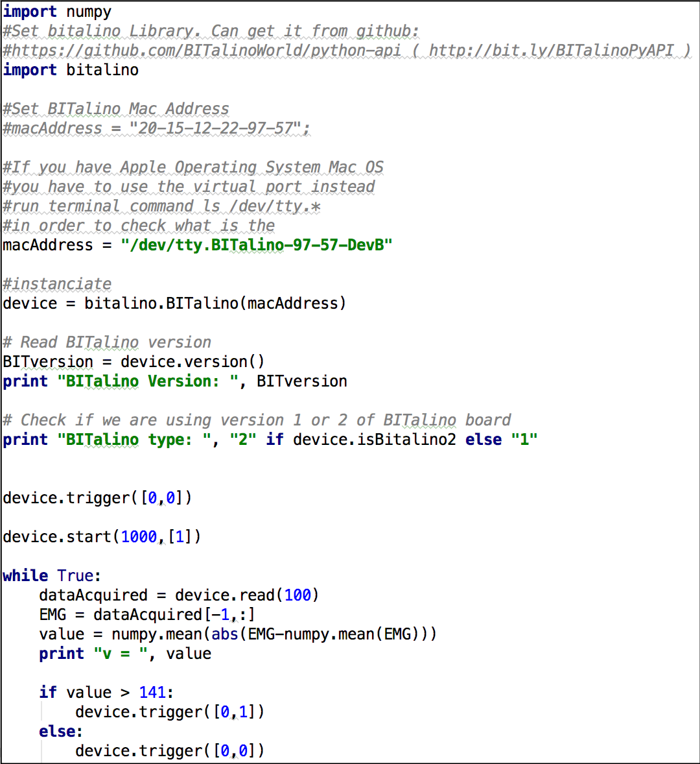

Slide 58
Import API

Slide 59
Set Communication
Mode/Address

Slide 60
API instantiation

Slide 61
Some Examples
Some Examples

Slide 62
How to trigger off
LED and Buzzer

Slide 63
Start Grab Data
From Sensor

Slide 64
let’s get to work

Slide 65
Python API
http://bit.ly/BITalinoPyAPI
Python Presentation Example
http://bit.ly/BITalinoCherryPickEx
More Information, Examples and APIs
http://www.bitalino.com

Slide 66
facebook.com/BITalinoWorld
twitter.com/BITalinoWorld

